Slide 1
SESSION 2
Hallucination: Causes and Impact

Slide 2
Defining Hallucination And Its Types

Slide 3
What is Hallucination in GenAI Systems?
Hallucination in the context of Large Language Models (LLMs) refers to the generation of content that is
Factually incorrect - contradicts real-world truth
Fabricated - invented without basis in training data or provided context
Nonsensical - logically inconsistent or incoherent
Unfaithful - contradicts the source material provided

Slide 4
What is Hallucination in GenAI Systems?
A hallucination is any generated content that appears plausible but is not grounded in the training data, provided context, or factual reality
OUTPUT
INPUT
“Marie Curie won the Nobel Prize for inventing the telephone in 1903”
“Who invented the telephone?”
LLM
HALLUCINATION
Wrong Person
Wrong Award
Fabricated

Slide 5
All LLMs can Hallucinate
LLMs are fundamentally statistical pattern matchers, not knowledge bases
LLMs don’t “know” things; they predict what text should look like based on patterns, which makes them prone to generating plausible-sounding falsehoods
What LLMs Do | What LLMs Don't Do
Predict likely next tokens | Understand truth
Match patterns from training | Verify facts in real-time
Generate fluent text | Distinguish fact from fiction
Complete probable sequences | Access live information

Slide 6
Taxonomy of Hallucinations
Hallucinations can be classified along multiple dimensions. Understanding this taxonomy helps in designing targeted mitigation strategies
HALLUCINATION
By source
By type
By impact
Intrinsic
Extrinsic
Factual
Fabrication
Logical
Error
Benign
Harmful

Slide 7
Hallucination By Source
Intrinsic Hallucination: Output contradicts the provided source/context
Example
Extrinsic Hallucination: Output contradicts real-world facts (cannot be verified from the provided context)
Example
Context: “The company was founded in 2015 by John Smith”
Query: “When was the company founded?”
Hallucinated Response: “The company was founded in 2010 by Jane Doe.”
Query: “What is the boiling point of water?”
Hallucinated Response: “Water boils at 150°C at standard atmospheric pressure.”
Contradicts real-world fact (100°C)
Contradicts provided context

Slide 8
Hallucination By Type
TYPE 1: FACTUAL FABRICATION
Inventing facts, entities, events, or citations that don’t exist
Examples
“The Battle of Thornwood in 1847…” (event never happened)
“According to Smith et al. (2019)…” (paper doesn’t exist)
“The Zelmon Protocol requires…” (made-up standard)
TYPE 2: REASONING ERROR
Logical inconsistencies, incorrect inferences, math errors
Examples
If A > B and B > C, then C > A (logical fallacy)
25% of 80 is 25 (math error = 20)
Therefore, all mammals can fly (invalid conclusion)
TYPE 3: MISSING-CONTEXT ERROR
Filling gaps with assumptions when information is unavailable
Examples
Assuming default values for unspecified parameters
Inventing details to complete an incomplete story
Making up user preferences when not stated
TYPE 4: ENTITY CONFUSION
Mixing up similar entities, people, or concepts
Examples
Attributing Einstein’s quotes to Hawking
Confusing Python (language) with Python (snake)
Merging facts about similar companies or products

Slide 9
Hallucination By Severity
SEVERITY SPECTRUM
Low
Medium
High
BENIGN
Trivial Errors
Easily Caught
No real harm
MODERATE
Misleading but not harmful
Requires correction
SEVERE
Dangerous Advice
Medical/Legal misinformation
Financial harm
Example
“Shakespeare wrote 37 plays”
(actually 37-39)
Example
“The Eiffel Tower was built in 1920”
(actually 1889)
Example
“You can take 20 aspirins at once”

Slide 10
Detection Difficulty
Dimension | Categories | Detection Difficulty
Source | Intrinsic, Extrinsic | Intrinsic easier (context available)
Type | Factual, Reasoning, Context, Entity | Reasoning errors hardest to detect
Severity | Benign, Moderate, Severe | Severity is domain-dependent

Slide 11
Causes Of Hallucination

Slide 12
Why do LLMs Hallucinate?
Understanding why hallucinations occur is essential for developing effective mitigation strategies
HALLUCINATION
Training
Causes
Model
Causes
Inference Causes
Data quality
Data gaps
Noise/errors
Outdated info
Biased sources
Architecture
No knowledge boundary
Model overfitting
Shallow models
Prompt ambiguity
Temperature settings
Context window limits
Lack of grounding

Slide 13
Cause 1: Training Data Limitations
INCOMPLETE COVERAGE
  Data is a small subset of all knowledge
  Models only learn from the data they are trained on, which cannot represent everything that exists or happens in the real world
TEMPORAL CUTOFF
  Models are blind to events after their training date
  For recent or ongoing events, the model may generate plausible but fictional continuations
  This can lead to confident answers that are outdated or incorrect

Slide 14
Cause 1: Training Data Limitations
NOISE AND ERRORS IN TRAINING DATA
  Training data contains inaccuracies and misinformation
  LLMs learn from both high-quality and low-quality sources
  Forums, blogs, and social platforms may contain incorrect or biased information
  Errors present in data can be reflected in model outputs
SOURCES OF TRAINING INFORMATION
  Scientific Papers — Reliable
  Wikipedia — Mostly accurate
  News Articles — Quality varies
  Reddit / Forums — Often incorrect

Slide 15
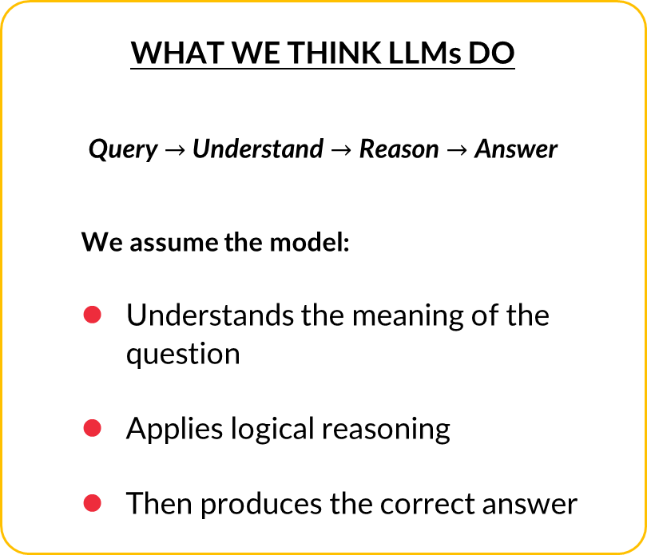
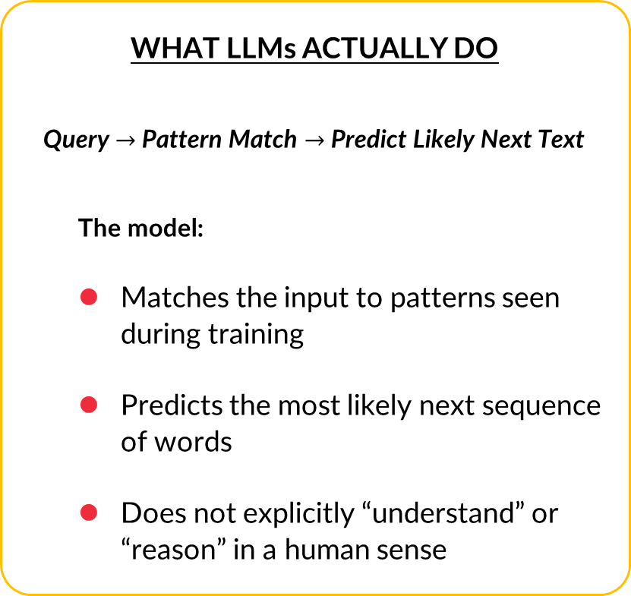
Cause 2: Model Causes
LLM rely on statistical patterns rather than true reasoning during generation
WHAT LLMs ACTUALLY DO
Query $→$ Pattern Match $→$ Predict Likely Next Text
  The model:
  Matches the input to patterns seen during training
  Predicts the most likely next sequence of words
  Does not explicitly “understand” or “reason” in a human sense
WHAT WE THINK LLMs DO
Query $→$ Understand $→$ Reason $→$ Answer
  We assume the model:
  Understands the meaning of the question
  Applies logical reasoning
  Then produces the correct answer

Slide 16
Cause 2: Model Causes
EXAMPLE: WHY MATH IS HARD FOR LLMs
Human Approach
  Recognises that 47 × 23 requires a calculation
  Applies arithmetic rules to compute the answer
LLM Approach
  Predicts what text usually follows the pattern: “47 × 23 =”
  If many similar examples exist in training data, it may output the correct value
  If not, it may output a plausible-looking number rather than a calculated one

Slide 17
Cause 2: Model Causes
THE PATTERN-MATCHING TRAP
What the model sees during training
  “Einstein developed …” → the theory of relativity
  “Einstein won the Nobel Prize for …” → physics
So when asked: “Einstein won the Nobel Prize for his theory of …”, the model predicts “relativity” (based on strong patterns)
But this is incorrect; “Einstein won the Nobel Prize for the photoelectric effect, not relativity”
The pattern “Einstein + Nobel + theory” → “relativity” is stronger than the actual fact

Slide 18

Cause 3: Inference Causes
PROMPT AMBIGUITY
Issue: User intent is unclear
Example prompt: “Explain the bank.”
Possible interpretations by the model
  Bank of a river (land alongside a body of water)
  Financial institution (accepts deposits)
Impact
  The model may give an answer that is correct in isolation but not what the user intended
  Vague prompts increase the risk of misinterpretation and incorrect context
EXAMPLE
User: “Explain the bank.”
LLM
LLM Output
“The land alongside a body of water…”
(Accurate but unintended)
LLM Output
“A financial institution that accepts deposits…”
(Intended but missed)

Slide 19
Cause 3: Inference Causes
TEMPERATURE SETTINGS
Temperature controls randomness in output
Low temperature (e.g., 0.1 – 0.3)
  More deterministic
  Repeats common patterns
  Safer, but less creative
High temperature (e.g., 0.8 – 1.0)
  More creative and diverse
  Higher risk of unusual or incorrect connections
Impact: High temperature can increase the chance of fluent but incorrect or nonsensical outputs
EXAMPLE
Temperature
Low (0.1)
Deterministic
High (0.9)
Creative/Random
“The cat sat on the mat.”
“The cat sat on the mat and then flew to the moon with a spoon, singing about purple broccoli.”

Slide 20


Cause 3: Inference Causes
CONTEXT WINDOW LIMITS
Issue: Limited memory of long conversations
What happens
  Earlier parts of the conversation may be truncated
  The model may no longer “see” important earlier information and may invent a new answer
Impact: Loss of earlier context can lead to inconsistency and fabricated continuations
EXAMPLE
-----Forgotten Context-----
User: “So, what did you say about the first point?”
LLM: “I’m sorry, I don’t recall the first point. Here’s a new fact….”
Limited Memory

Slide 21
Cause 3: Inference Causes
LACK OF GROUNDING IN REAL-WORLD FACTS
Issue: No guaranteed access to verified external data
What the model does
  Relies on learned text patterns
  Connects loosely related concepts
Example fabricated output
“The Eiffel Tower was built on Mars in 1845 by avocado farmers.”
Impact: Without real-time verification, the model may generate confident but false statements
EXAMPLE
Avocado
Eiffel Tower
LLM
1845
Mars
LLM output
“The Eiffel Tower was built on Mars in 1845 by avocado farmers.”

Slide 22
Risks Associated With Hallucinations

Slide 23
Impact on User Trust
User trusts AI output
User relies on AI decision
Hallucination discovered
Hard to get back trust (slow rebuild)
User becomes sceptical
Trust is damaged
Trust Erosion Cycle: One significant hallucination can undo months of positive user experiences with an AI system

Slide 24
Risks in User-Facing Applications
CRITICAL RISK DOMAIN
Healthcare
Hallucination: “This drug interaction is safe”
Impact
  Patient harm
  Potential fatality
Example: AI suggests medication that interacts dangerously with patient’s existing prescriptions

Slide 25
Risks in User-Facing Applications
CRITICAL RISK DOMAIN
Legal
Hallucination: Fabricated case citations
Impact
  Court sanctions
  Malpractice
  Case dismissal
Example: Lawyer cites non-existent precedents

Slide 26
Risks in User-Facing Applications
CRITICAL RISK DOMAIN
Financial
Hallucination: Incorrect tax advice or financial figures
Impact
  Financial losses
  Regulatory penalties
  Fraud
Example: AI miscalculates tax liability by 50%

Slide 27
Risks in User-Facing Applications
MODERATE RISK DOMAIN
Education
Hallucination: Incorrect facts taught to students
Impact
  Misinformation propagation
  Wrong learning
Example: AI tutoring system teaches incorrect history

Slide 28
Risks in User-Facing Applications
MODERATE RISK DOMAIN
Customer Service
Hallucination: Wrong product information or policies
Impact
  Customer frustration
  Returns
  Brand damage
Example: Chatbot promises non-existent refund policy

Slide 29
Risks in User-Facing Applications
LOW RISK DOMAIN
Creative / Entertainment
Hallucination: Invented plot details, wrong attributions
Impact
  Minor inconvenience
  Potential embarrassment
Example: AI incorrectly attributes a quote to an author

Slide 30
Impact on Downstream Decisions
AI Output
(with hallucination)
Human Decision
(based on AI)
Action Taken
Secondary Decisions
(by others)
Tertiary Effects…
COMPOUNDING NEGATIVE IMPACT

Slide 31
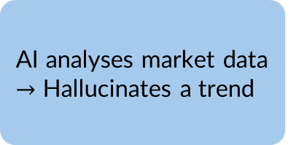
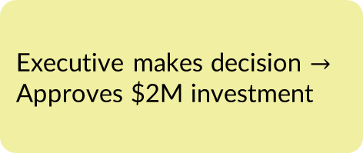
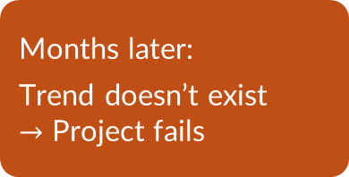
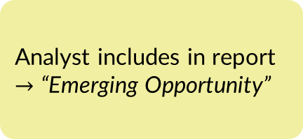
Impact on Downstream Decisions
Real-World Scenario
AI analyses market data $→$ Hallucinates a trend
Analyst includes in report $→$ “Emerging Opportunity”
Executive makes decision $→$ Approves $2M investment
Team hired
Resources allocated
Months later:
Trend doesn’t exist
$→$ Project fails
Layoffs
Financial loss
Trust in AI tools damaged
The initial hallucination propagated through the decision chain and amplified in impact at each stage

Slide 32
Risk Assessment Matrix
Domain | Hallucination Type | Likelihood | Impact | Risk Level
Healthcare | Medical facts | Medium | Severe | Critical
Legal | Case citations | High | Severe | Critical
Finance | Numbers/calculations | Medium | Severe | Critical
Education | Historical/scientific facts | High | Moderate | High
Customer Service | Policy information | Medium | Moderate | Medium
Content Creation | Attribution/facts | High | Low-Moderate | Medium
Entertainment | Creative details | High | Low | Low

Slide 33
Mitigation Strategies for Hallucination

Slide 34
Overview of Mitigation Strategies
Hallucination mitigation in LLM is not a one-time approach, but instead a multi-step layered approach
LLM Application
Prompting
(before generation)
Reference-Based Answering
(during generation)
Verification
(after generation)
System Prompts
Few-shot Examples
Instruction Tuning
Uncertainty Cues
Knowledge Bases
Document Retrieval
Context Grounding
Real-time Data
Fact Checking
Source Citation
Human Review
Confidence Scores

Slide 35
Strategy 1: Prompting Techniques
TECHNIQUE 1: EXPLICIT UNCERTAINTY INSTRUCTIONS
Basic Prompt: “Answer the question about history.”
Improved Prompt: “Answer the user’s question about history. If you are not certain about a fact, explicitly say “I’m not certain” or “This may require verification.” Never fabricate dates, names, or events. If you don’t know, say so.”

Slide 36
Strategy 1: Prompting Techniques
TECHNIQUE 2: CHAIN-OF-THOUGHT (CoT) PROMPTING
Example Prompt: “Break the problem into clear steps. State assumptions and verify each step before giving the final answer.”
Example Response
  Step 1: Identify what the question is asking
  Step 2: Apply the relevant rule or formula
  Step 3: Check if the result is reasonable
  Final Answer: …

Slide 37
Strategy 1: Prompting Techniques
TECHNIQUE 3: SYSTEM INSTRUCTIONS
Define role and boundaries clearly
Example: “You are a customer support assistant. Answer only using the provided product information. If unsure, say that the information is not available.”

Slide 38
Strategy 2: Reference-Based Answering
WITHOUT REFERENCES
Risk: Model may guess when information is missing and higher chances of fabricated or outdated answers
WITH PROVIDED REFERENCES
What changes: Model uses supplied documents or data and answers stay within known, verified material
User Query
LLM
(relies only on training)
Response
User Query
Relevant Information Provided
LLM
Response

Slide 39
Strategy 2: Reference-Based Answering
HOW REFERENCE-BASED ANSWERING WORKS
Prompt = Question + Relevant Information + Instructions
Types of references that can be provided
  Policy documents
  Product manuals
  Internal reports
  Approved knowledge sources
  Recent or task-specific data
  (References can be added manually or through automated systems)

Slide 40
Strategy 3: Verification And Fact Checking
COMMON PRACTICES
Fact Checking: cross-verify key claims
Source Citations: require supporting references
Human Review: expert validation for critical domains
Confidence Indicators: flag uncertain answers

Slide 41
Layered Mitigation Approach in Production Pipelines
RAW INPUT
LAYER 1 Prevention
(before generation)
LAYER 2
Grounding
(during generation)
LAYER 3
Detection
(after generation)
LAYER 4
Human Oversight
(final check)
VERIFIED
OUTPUT
Well-Crafted Prompts
Domain-Specific Fine-Tuning
Connects to verified knowledge bases and real-time data
Automatically checks for factual errors
Consistency Checks
Confidence Scoring
Implements expert review for high-stakes cases
Gathers user feedback for improvement
No single layer is sufficient: All four layers must be used together for a robust defence against errors

